Slide 1
Party discipline in brazil’s chamber of deputies 2002-2020
PLSC 31101 Final Project
Lautaro Cella

Slide 2
Brazil’s Chamber of Deputies
513 deputies elected by proportional representation to serve 4-year terms
Multi-party system.
Roll call votes: each deputy explicitly chooses an option (Yes, No, Abstain) and all votes are recorded
Rice Index: | percent of YES votes - percent of NO votes |

Slide 3
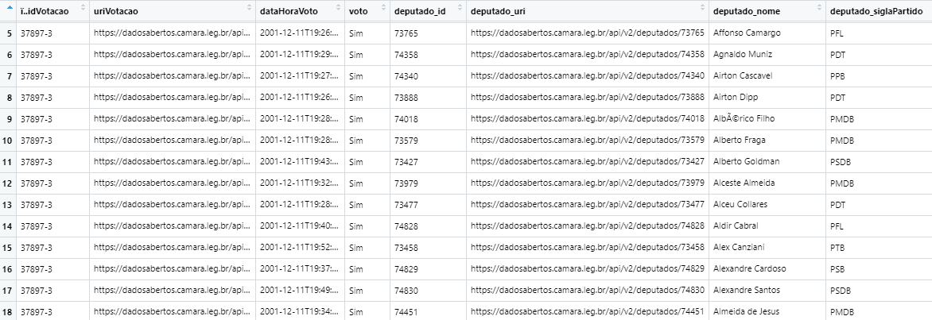
Collecting data
Create function get_csv() and use map_dfr() to apply function to 2002:2020
‘https://dadosabertos.camara.leg.br/arquivos/votacoesVotos/csv/votacoesVotos-',u,'.csv'

Slide 4
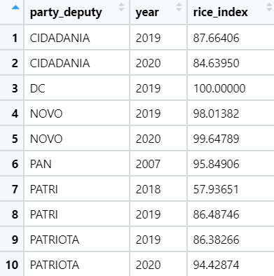
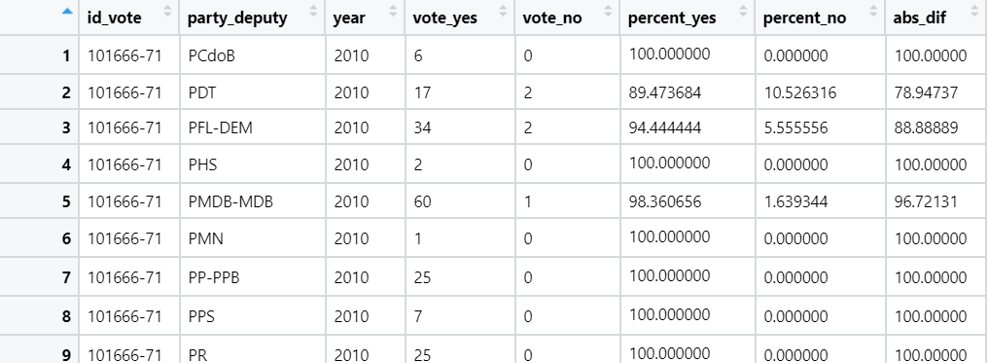
Cleaning data

Slide 5
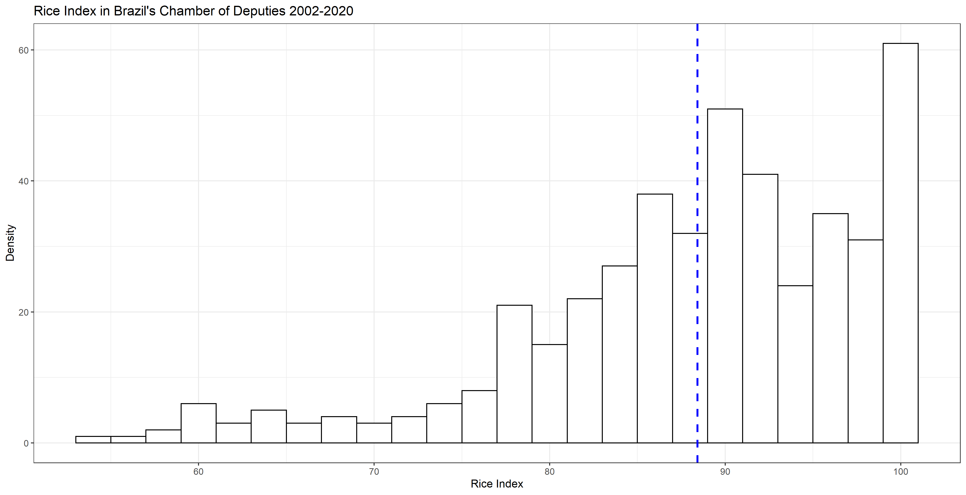
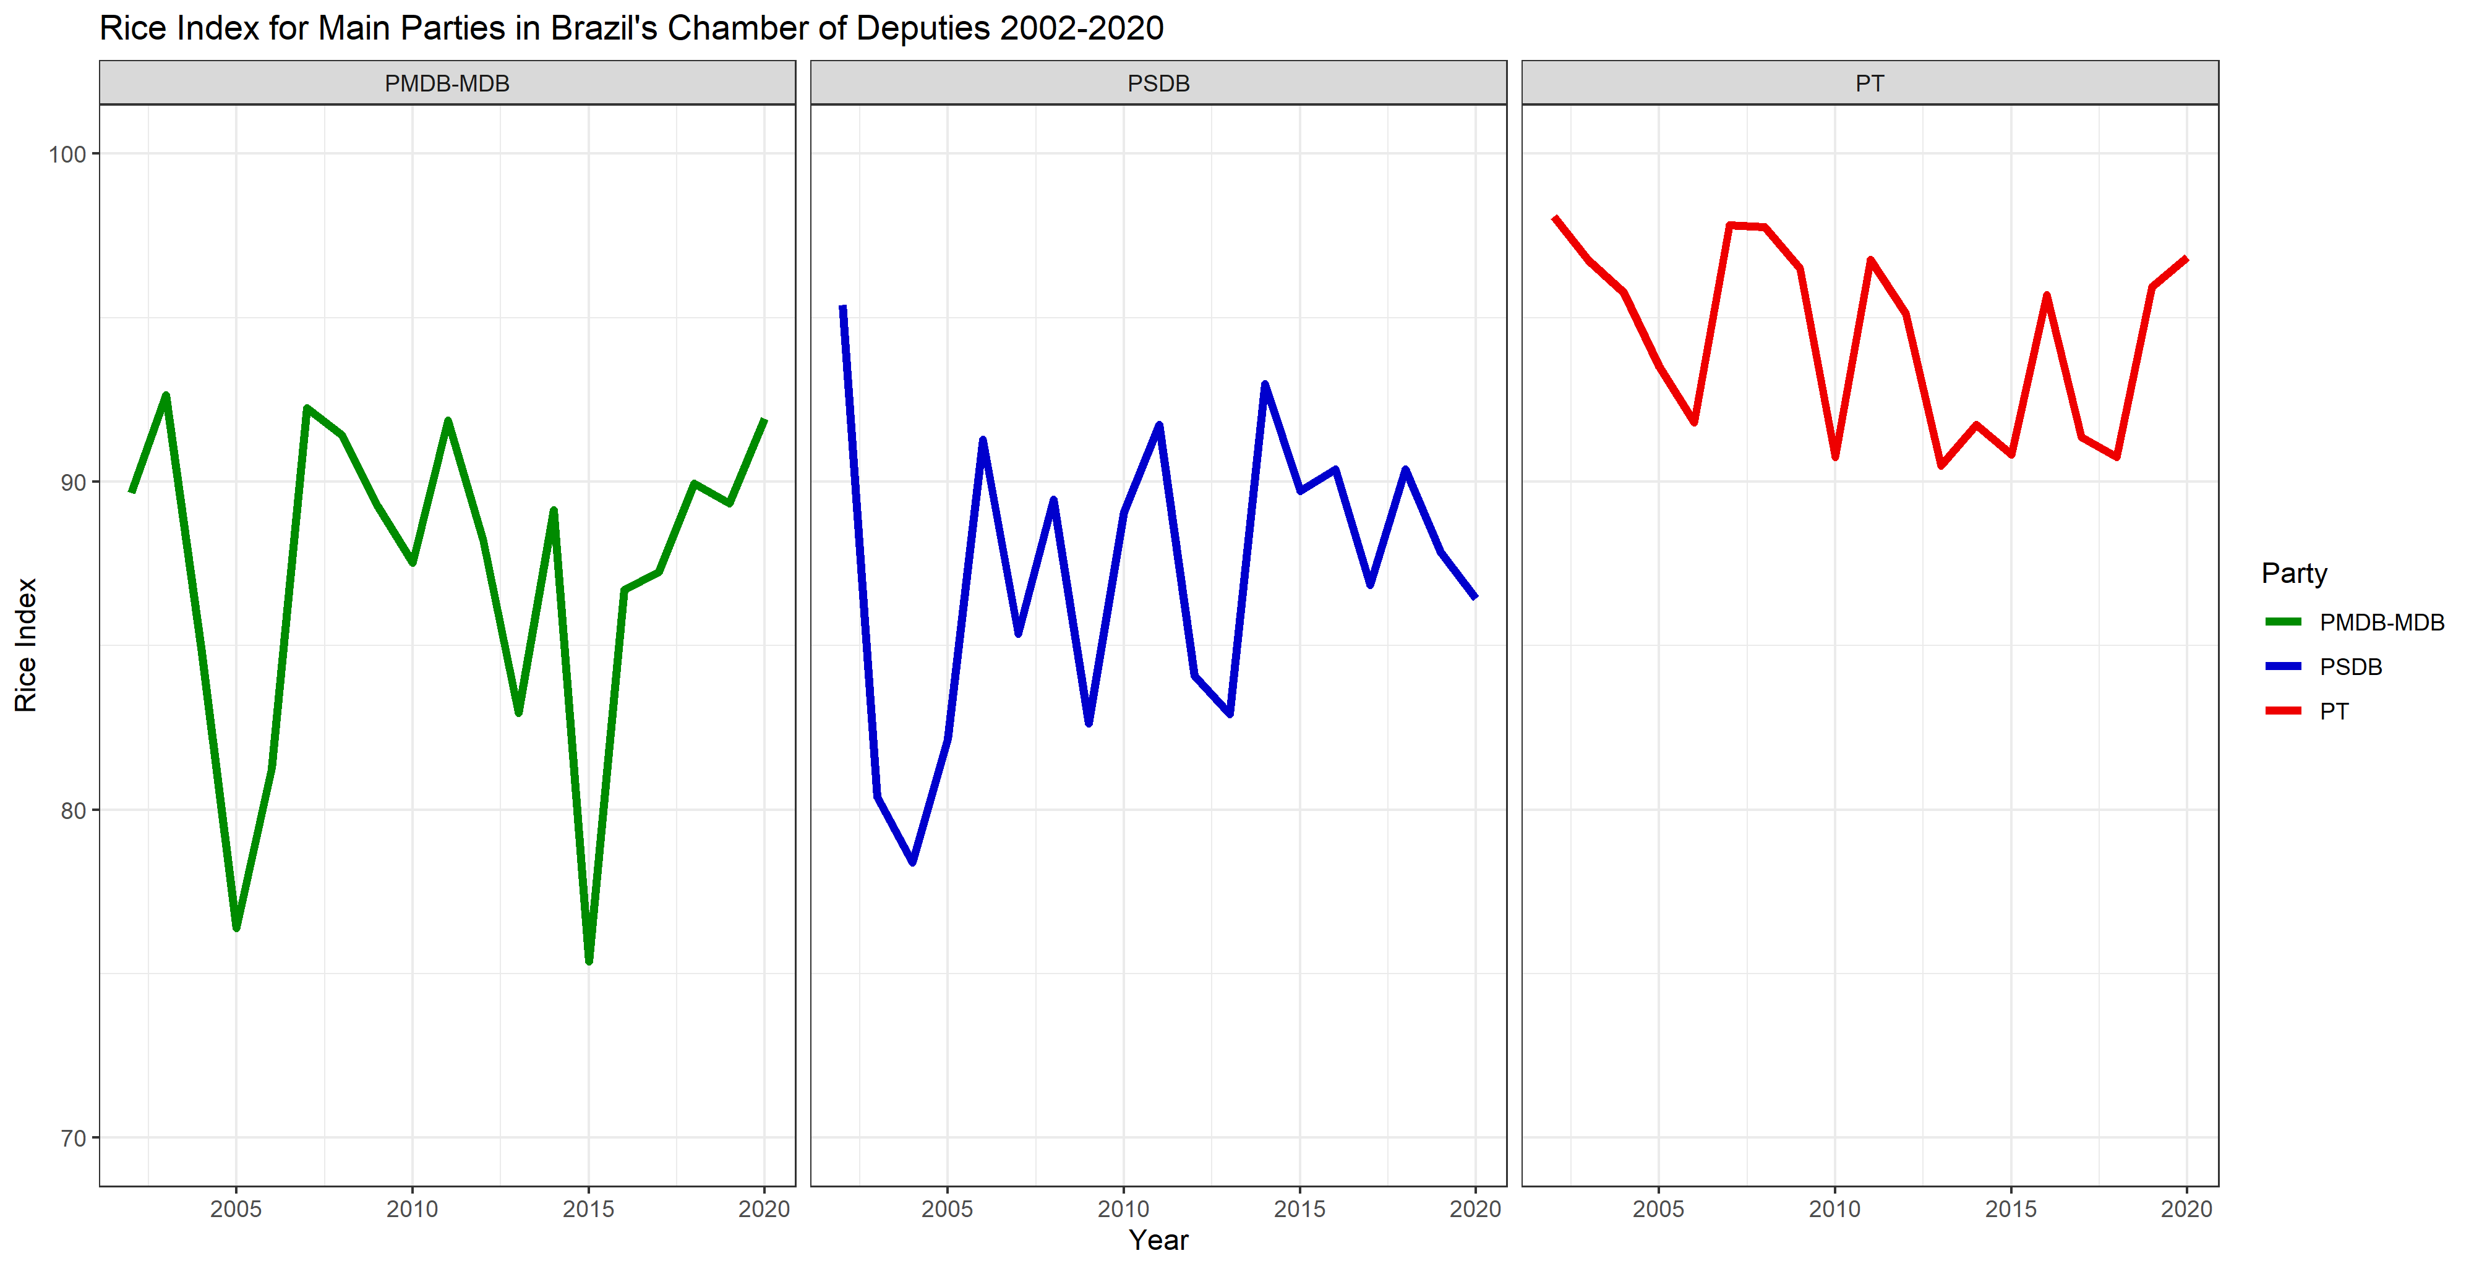

Slide 6
Brazilian Legislative Surveys Data
Do you think that members of Congress should vote with their party or according to their personal beliefs?
0 According to his/her beliefs
1 According to the party
Percentage of surveyed party members who believe that deputies should vote with their party (not according to their beliefs) for each party-year
Merge two data frames

Slide 7
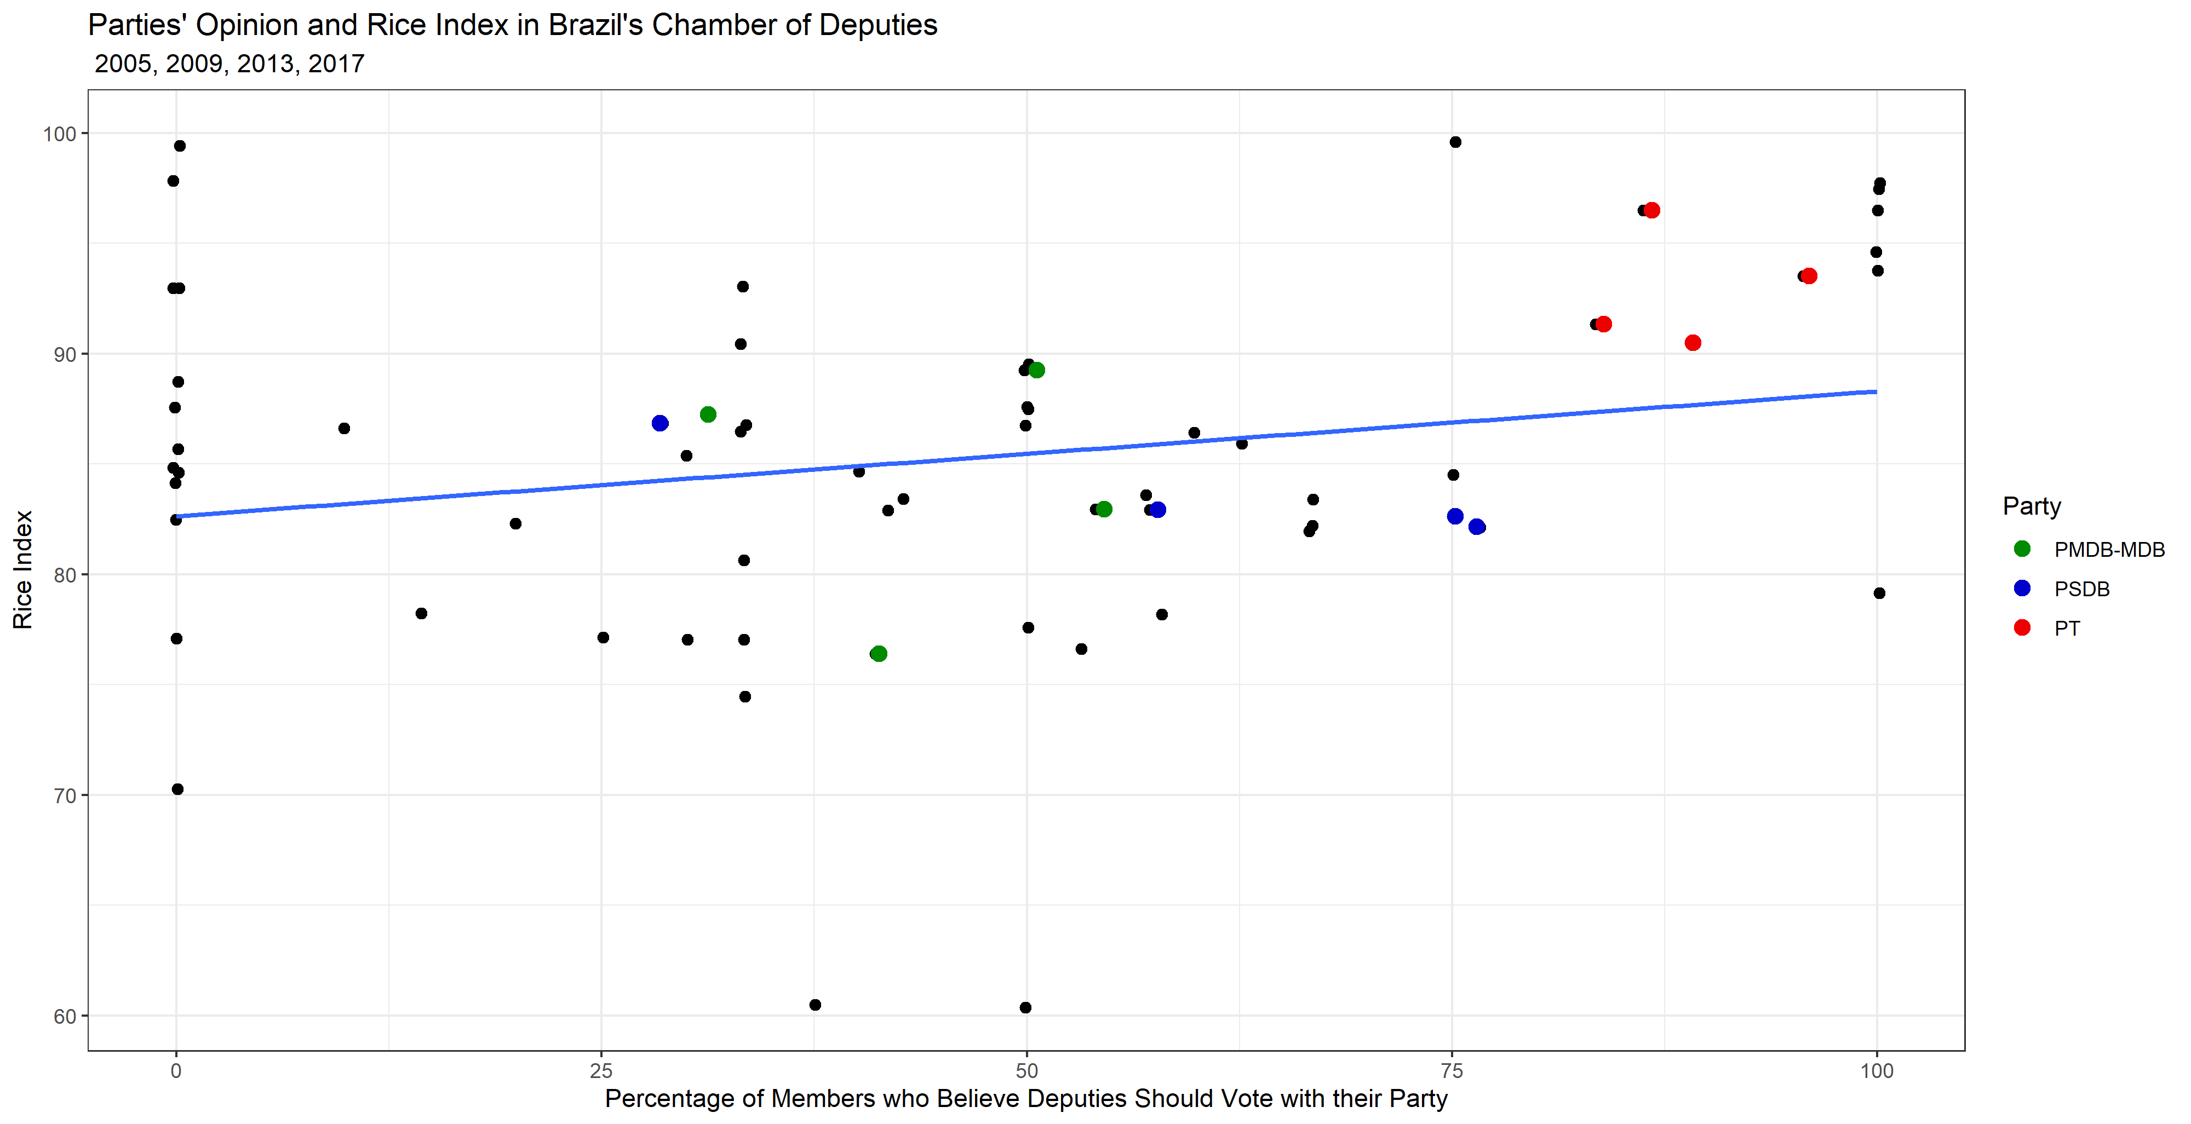
Results

